Slide 1
Royal Arch Mason Centennial Award
Sarah Candy 2021

Slide 2
Notes:
I would like to start by saying a sincere thank you to the Royal Arch Masons. Thank you for inviting me to your annual meeting, for listening to my presentation today, but most importantly for supporting my ongoing study and research. I am incredibly grateful for your support and I would like to acknowledge the amazing advocate Ron Lane has been for me… Thank you …. I am really excited about the work we are doing in our research and your support allows me time to focus on this work.

Slide 3
What a year ….
Notes:
This time last year in Nelson, we were talking about this

Slide 4
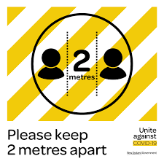

Slide 5
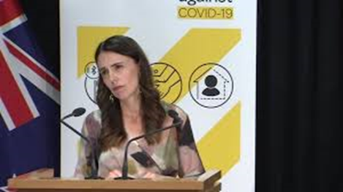
1pm updates

Slide 6
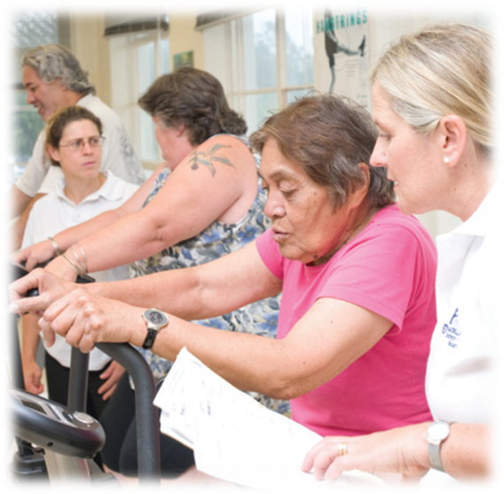
To recap …
Developing an mHealth application for pulmonary rehabilitation
Notes:
By mHealth we mean using mobile technology to deliver a health intervention.
Pulmonary rehabilitation is an ambiquous term – at CMH we have renamed out programme to better breathing, in order to make it more relatable …
However, the medical terminology is pulmonary rehabilitation – referring to the lungs and rehabilitation is a process of regaining health and independence…

Slide 7
What is pulmonary rehabilitation
“a comprehensive intervention based on a thorough patient assessment followed by patient tailored therapies that include, but are not limited to, exercise training, education, and behaviour change, designed to improve the physical and psychological condition of people with chronic respiratory disease and to promote the long-term adherence to health-enhancing behaviours.” (Spruit et al., 2013)
Notes:
This is the international definition of PR.

Slide 8
“ Just do it! I couldn’t even walk before.
I’d be so out of breath, but now I’m even able to play and run around with my grandkids.”
Notes:
PR works! There is a huge wealth of evidence to prove its effectivessness…. But I think Mary sums it up beautifully ….

Slide 9
The problem is …
Less than 1% of the people in NZ who have COPD and would benefit from PR attend each year.
Notes:
We know that COPD is the 3rd leading cause of death in the world. In NZ COPD is a major problem in NZ…. We have 14 % of our population affected by COPD and this is only the proportion whoa re diagnosed…

Slide 10
Who is missing out?
Rural or isolated areas
Lower socio-economic groups
Gender disparities
Ethnic groups
Current smokers
Depression
Social isolation

Slide 11
Our goal
To develop an alternative method for delivering pulmonary rehabilitation to allow more people to have access to the intervention

Slide 12
What did I learn in 2020…
Notes:
Responsive services

Slide 13
What did this mean for people with a lung condition ?
Vulnerability
Social isolation
Fear
Reduced activity levels
Access to healthcare became even harder

Slide 14
What happened to pulmonary rehabilitation services in NZ
40% stopped services completely
Most services utilised telephone for consults
Notes:
Remind what PR is about ….

Slide 15
National survey

Slide 16
What did I learn in 2020…
We need flexible models of care
Services can not just STOP
Smart phones are not answer
Digital literacy is low
Digital access is low
Notes:
Responsive services

Slide 17
Changes to mPR
Moved from mobile-phone application to web based application
Core SMS programme
Paper based manual

Slide 18
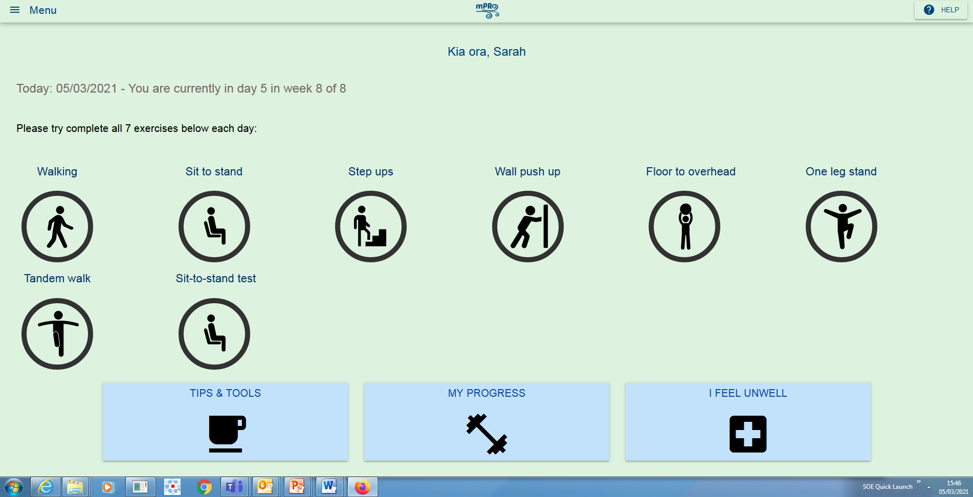
The latest version of mPR

Slide 19
The next steps …
Patient preference clinical trial
Referred to pulmonary rehabilitation
Patient choice
Centre based PR
mPR

Slide 20
What this means for participants
Centre based
Baseline assessment
Eight weeks supervised exercise and education
mPR
Baseline assessment
Follow up assessment
Follow up assessment
Eight weeks exercise and education
Daily tailored text message
Exercise prescription
Access to tips and tools

Slide 21
Process …
Pre trial
Trial
Post trial
Study protocol
Ethics approval
Trial registration
Study SOP

Slide 22
Process …
Pre trial
Trial
Post trial
Attendance
Exercise capacity
Symptoms
Quality of life
Participant feedback

Slide 23
Process …
Pre trial
Trial
Post trial
analysis
Research report
Dissemination

Slide 24
Timeline
 | Mar | Apr | May | June | Jul | Aug | Sept | Oct | Nov | Dec
Pre trial
Trial
Post trial

Slide 25
Questions

Slide 26
Thank you

Slide 27
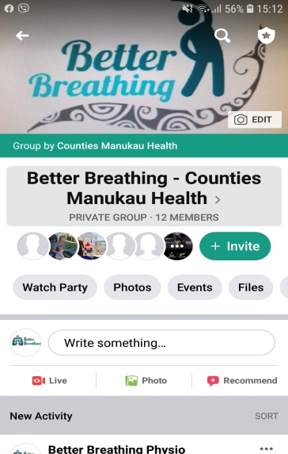
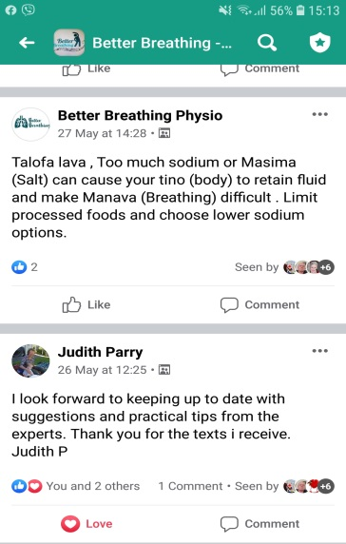
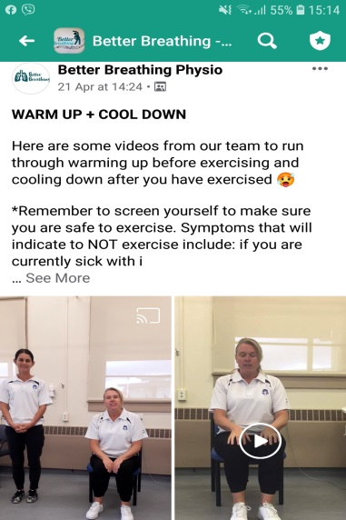
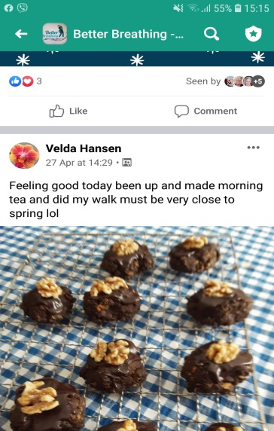
Social media & self management
Emotional and educational support
Facebook and Whatsapp

Slide 28
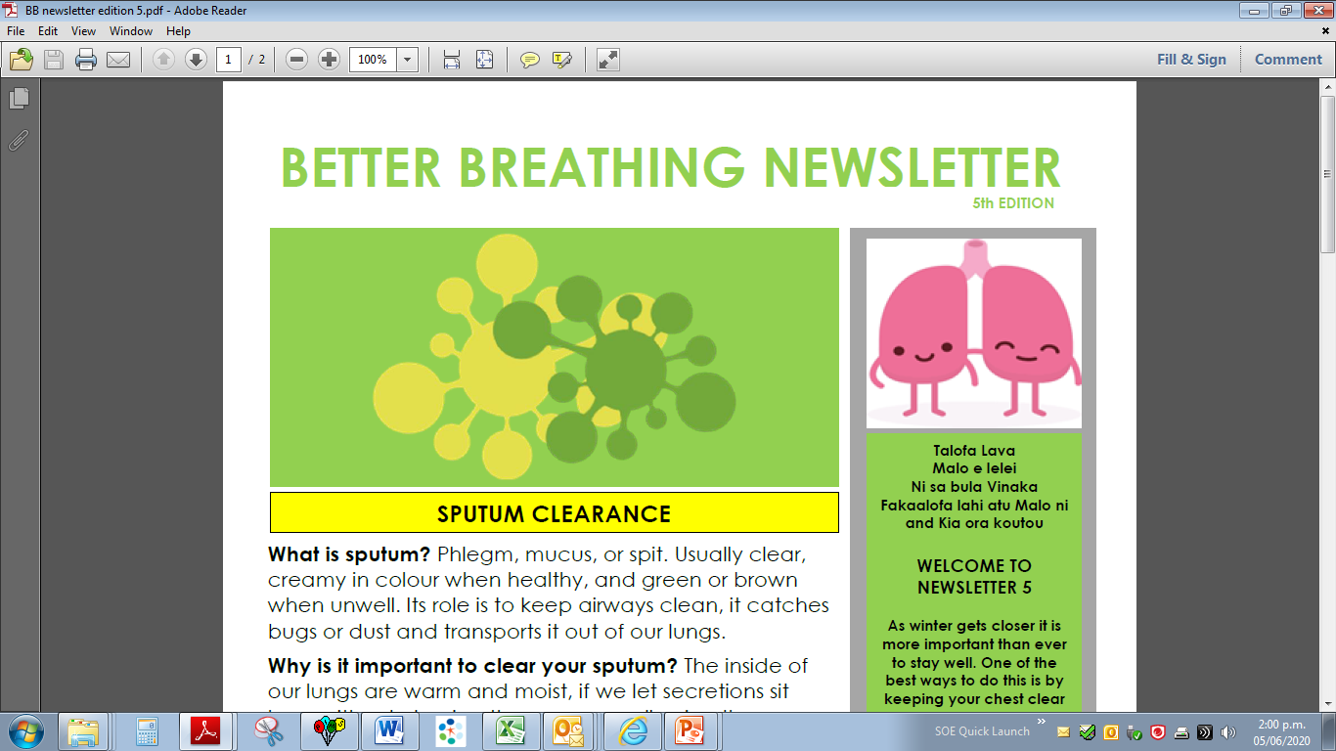
Topic of the week

