Slide 2
Our Modus Operandi
Equality – no rank on the ORWG
We are all Freemasons – not being done to you.
A group of volunteers giving up their time to try and do the right thing for Freemasonry
Evolution not Revolution:
No design is perfect
80:20 Rule
It’s not our design its OUR design
The proposed structure is designed to change with time – tempus fugit.

Slide 3
The Working Group
Masonic Experience
Geographic Representation
Professional & Life Experience
RW Bro. Kevin Nelson Past Deputy Grand Master (Chair)
MW Bro. Graham Wrigley Past Grand Master – Trustee Representative
RW Bro. Russell Pratt Past Divisional Grand Master
W Bro. George Swanepoel Past Master, Northland
W Bro. Shane Paterson Master, Auckland
W Bro. Kieran Crickmar Past Master, Wellington
VW Bro Steve Griffin, District Grand Master, Hutt Wairarapa District
VW Bro Andrew Alexander, District Grand Master, Auckland District
W Bro. Bill Taylor Past Grand Steward (Secretariat)
Notes:
Narrative
The Working Group is representative of
Masonic experience
Geographic representation
Professional and life experience
Masonic and Personal leadership
A mix of Masonic tenure and age
The brief was defined in a Terms of Reference document approved by the Board of General Purposes in May, 2023. A copy is available on the Grand Lodge of New Zealand national website, and will be sent following this Seminar
Our approach has been to agree a number of ‘problem statements’ that if successfully addressed would create an environment where Lodges can thrive

Slide 4
Purpose
To recommend a structure which is fit for purpose for New Zealand Freemasonry
Notes:
Narrative
The purpose of the Working Group was clearly identified as part of the Terms of Reference

Slide 5
The burning platform
Doing nothing is not a choice

Slide 6
There are no sacred cows

Slide 7
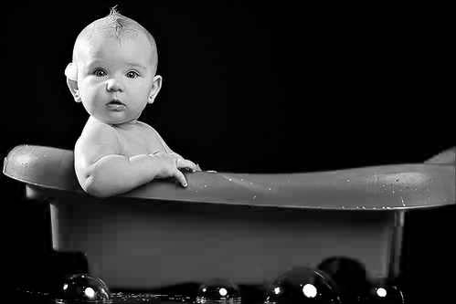
Baby … bath water …

Slide 8
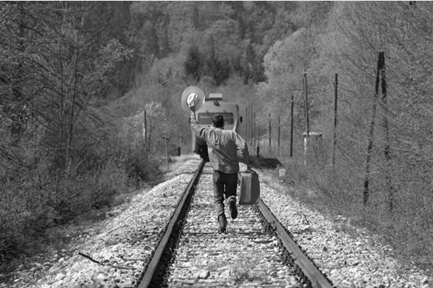
The train has left the station …..

Slide 9
Our Problem statements
Tactical challenge | Mitigation
Reduced pool of future leaders | Attract members with leadership potential
Current structure designed for larger membership | Reduce ‘layers’ and roles to suit current and future
Limited strategic decision making | Empower leaders to be strategic and make decisions
Lacking action bias | Reduce ‘layers’ to expedite action
Notes:
Narrative
- Our ‘gene pool’ is depleted – we have to compromise when choosing leaders, not always ‘the best man for the job’
- Our current structure was designed when membership was 5 x larger and has some inefficiencies and complexity
- To compete in a more mature and complex world we must present a more ‘polished’ approach
- Progress on initiatives is never ever faster than ‘glacial’ e.g. Lodge Champions programme; new website; new membership system
- Post code politics still runs rife

Slide 10
Our Problem statements
Operational challenge | Mitigation
Diminishing interest in taking office | Providing ‘top cover’
Diminishing interest in delivering charges | Encouragement and support to deliver
Inability to fill Chairs at meetings | Pastoral care to demonstrate value
Inability to form a quorum at meetings | Seek alternatives to ensure viability
Crippling deferred maintenance and insurance costs | Active engagement of Property Committee
Slipping standards of Ritual | Encouragement and support to deliver
Overall member conduct has deteriorated | Call out bad behaviour and escalate
‘Cringe factors’ intensify as Lodges become smaller | Address bad behaviour and escalate
Notes:
Narrative
- Fewer brethren are seeking to take office – we have a succession challenge
- Fewer brethren are delivering charges – taking the time to learn and being criticised for their performance
- Reduced attendance of Officers causes ‘gaps’ and requires Visitors to ‘fill in’ ​- leading to poor performance and diminished candidate experience
- Poor attendance at meetings threatens viability of Lodges and leads to a poor experience for brethren
- Increasing costs of maintaining and insuring buildings are a threat to Lodges​ - we cannot afford our meeting places
- Slipping standards of ritual means reduced enjoyment attending meetings
- Influential members are more vocal and critical – leading to new/young members staying away
- Those demonstrating the ‘Cringe factors’ are more prominent, as these brethren are often key contributors, and their behaviour turns people away

Slide 11
Skinning the cat
Structure:
Divisions, Districts, boundaries/geography
Machinery:
Protocols; roles; rank; ceremonial; dress; where we can meet
Settings and Tools:
Density; property; activity; affordability; tools
Personas/Pathways:
Assist those Lodges who wish to grow; assist those that want to die; consolidate buildings; define the masonic experience; better understand what our members want
Notes:
Narrative
To keep focussed on the primary outcomes we split the Terms of Reference into several groups or ‘chunks’
Structure – We looked at our structure and hierarchy, our Districts, Regions, and borders, and how geography supports or hinders Lodges
Machinery – We reviewed our protocols and traditions, the actual role each Rank plays, the Ceremonies and customs, the dress code and standards, and options on where we could meet appropriately
Settings and Tools – We considered where people live, population growth, our member demographics (now and in future), how we ‘live’ now, costs, and what can be put in place to support our organisation
Personas/Pathways – it sounds a bit ‘corporate’ but its all about how we show up as Freemasons, what our brethren and Lodges would like to achieve, how this can be supported, understand the needs and wants of our brethren, and how being a Freemason is an enjoyable and fulfilling experience for all

Slide 12
The Surveys
Summary of results

Slide 13
Surveys
Survey 1:
Tools and Settings
Sent to 2,300 brethren
437 responses (19%)
Survey 2:
Personas and Pathways
Sent to 2,300 brethren –
310 responses (13.5%)
A good survey response is between 5% and 30%, and an excellent response rate is 50% or higher.
Notes:
Narrative
Two surveys were conducted to assist our understanding of what brethren want – seeking to understand so we can create consensus
The overall response rate was 16.3% - this is good because the average response rate for “unsolicited” surveys is 3 – 5%
This suggests a very high level of engagement from our brethren

Slide 14
Tools and Settings Survey

Slide 15
What we asked you (Tools and Settings Survey)
presented a list of possible tools
what could be developed to assist Lodges?
how to better understand the needs of brethren?
what do Lodges need to do to thrive?
Notes:
Narrative
The Tools and Settings survey question
Russell to update and bullet point key points

Slide 16
What you told us:
% that either agreed or strongly agreed
A free digital survey should be provided to enable a Lodge to assess the extent to which it is thriving.
District Grand Masters should maintain an accessible register of who can perform charges to enable smaller Lodges to seek assistance if they can’t perform the work themselves.
District Grand Masters should provide templates and guides to assist willing Lodges to merge.
District Grand Masters should provide access to local skilled resources who can, in an unbiased way, assist a Lodge in determining their trajectory.
District Grand Masters should provide access to mentoring capability from within a Division/District (probably from Lodges that are already thriving) to help Lodges understand what it takes to thrive.
National Office should develop and provide a tool that can assist a lodge in determining the viability of its building.
80%
85%
73%
74%
80%
73%
Notes:
Narrative
The Tools and Settings survey question
The highlighted items are those that received the highest level of support

Slide 17
What you told us …cntd:
% that either agreed or strongly agreed
National Office should provide a mechanism to Lodges that enables a site visit (at no cost to the Lodge) from the GSuptW to make recommendations on the viability of the building.
National Office should provide Lodges with access to a property expert for guidance on driving additional revenue from a Lodge Building through opportunities to rent space.
National Office should develop and provide a tool to assist lodges navigate moving to a rented property without a dedicated Lodge Room and what to consider if planning to do this.
National Office should develop and provide a tool to assist Lodges in assessing how they should insure their building (i.e. demolition only; no earthquake cover, full cover, etc) for the best bang for their buck.
National Office should develop and provide templates and guides to assist a Lodge in establishing a non-ceremonial lodge.
73%
77%
65%
83%
46%
Notes:
Narrative
The Tools and Settings survey question
The highlighted items are those that received the highest level of support

Slide 18
What you told us …cntd:
% that either agreed or strongly agreed
National Office should develop and provide a tool that takes a Lodges’ input costs and then calculates what annual dues should be charged for the Lodge to remain viable.
National Office should develop and provide a tool that enables Lodges to survey non-attending brethren to better understand what a Lodge needs to do to bring them back.
National Office should develop and provide a framework to a Lodge for progressively retrieving non-attending meetings.
65%
80%
73%
Notes:
Narrative
The Tools and Settings survey question
The highlighted items are those that received the highest level of support

Slide 19
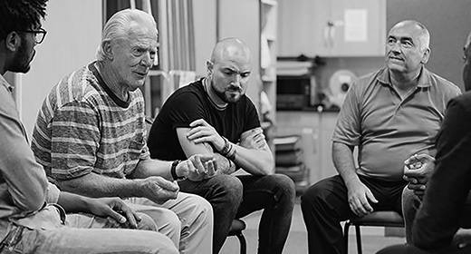
Personas and Pathways Survey

Slide 20
What we asked you (Personas and Pathways Survey)
how happy you are with the current Divisional & District Structure
about your interactions with leaders across your District/Division
whether you are happy with your lodge
whether you are happy the quality of ritual
If you are happy with your masonic experience
whether you are getting what you wanted from Freemasonry
Notes:
Narrative
The Personas and Pathways survey
Russell to update and bullet point key points

Slide 21
What you told us:
% that either agreed or strongly agreed
As an individual, you are satisfied with the level/amount of engagement from your District and Divisional Grand Masters.
As an individual you feel that you get value from the interactions with your District and Divisional Grand Masters.
As an individual, you are satisfied with your lodge
.
As an individual you are satisfied with the level/standard of ritual in your lodge.
As an individual, you are satisfied with what you get out of your Freemasonry.
As an individual, Freemasonry is what you believed it to be, and it is living up to your expectations.
63%
58%
70%
60%
71%
66%
Notes:
Narrative
The Tools and Settings survey question
The highlighted items are those that received the highest level of support

Slide 22
Key Takeaways

Slide 23
High level summary of key feedback from brethren
More work needs to be done on mentoring.
There seems to be a significant split opinion on whether we should leave the future of the Craft to younger people
Very few brethren knew anything about the Champions programme
Significant numbers don’t know about the ‘Young Masons’ initiative—several found the concept ‘ageist’ and felt that the group should focus on masons with fewer years' service rather than those who are younger in physical years.
Most brethren are satisfied with their Lodge – but relatively speaking, many are unhappy with the quality of their ritual (40%).
More than 80% of respondents said they were freemasons for life and had no intentions of leaving.
Notes:
Narrative
The Tools and Settings survey question

Slide 24
High level summary of key feedback from brethren ….cntd
Several comments suggest that non-attendance shouldn’t be interpreted as a lack of engagement – that many are ‘happy’ to belong – but do not attend.
Many commented that if freemasonry is simply the rote learning of 3 ceremonies – there’s not much future.
Many respondents spoke about getting ‘qualifications’ in leadership from their roles in freemasonry that can assist them with their professional career development.
A handful spoke of the lack of tolerance to Te Reo / others alluded to a lack of respect for sexual diversity.
Increased references to a belief in a supreme being as a barrier to joining.
Many brethren want greater access to digital channels – many suggested we develop a mobile app to help with ritual.
Notes:
Narrative
The Tools and Settings survey question

Slide 25
Evolution not Revolution

Slide 26
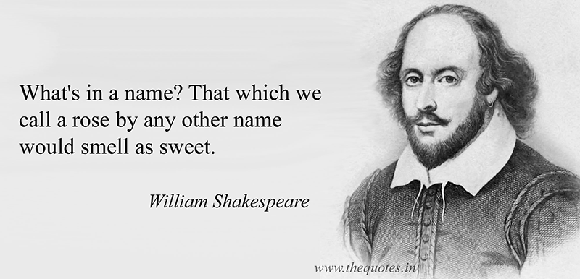
What’s in a name …

Slide 27
Recommendations
Establishing a Grand Superintendent of Education
Focused on Capability build, Development, Masonic Knowledge
Working closely with Research Lodges
Charity
Build the profile of District Charity Officers
Elevate the Grand Superintendent of Charity (RW) and Grand Almoners (VW)
Ceremonial
Re-establish the Grand Supt of Ceremonies
Preserve and incorporate District Customs
Notes:
Narrative
Our current structure works reasonably well, we don’t need to start again, only to update what we have in place
There is a growing perception that we have ‘too many chiefs’
The proposal and recommendations could be best described as Evolution not Revolution
Establishing G Supt of Educ
Considering alternative names – e.g. Grand Preceptor
Survey responses strongly indicated a desire for more education and capability build – on Masonic knowledge and related applicable skills
The G Supt will work with Research Lodges to create a strategy for their future and leverage their expertise
Charity
A key pillar of Freemasonry, we are recommending to increase our District focus on charity
And to elevate the profile of the Grand Almoner, and drive greater charitable focus through two Deputy Grand Almoners
Ceremonial
Re-establishing the G Supt Cer to identify the common ‘must have’ elements and fixed principles of Installations
And to preserve and celebrate the unique variations and customs of Districts and Lodges
Ensuring we deliver a great experience for Masters and Lodges

Slide 28
Recommendations
District Grand Masters focus on member engagement
Delivering Pastoral Leadership to Lodges
Supporting, enabling, empowering Lodges
Simplifying Administration
Balancing tradition with perceived relevance
Establish a Marketing and Membership role reporting to the Board
Actively engage brethren re Dress code and other items – Cultural Dress
Propose some structural change
New roles to meet our needs
Disestablish some roles to consolidate leadership
Notes:
Narrative
Dist GMs focus on supporting and enabling our brethren and Lodges
Focusing on the engagement of brethren
We see delivering pastoral care and leadership is the biggest factor to enable Lodges to thrive
Simplifying Administration to enable focus on brethren
This will likely mean Ceremonial organisation and resourcing is led by the Dist GDC, giving the Dist GM more time for Pastoral leadership
Balancing tradition with perceived relevance
Retaining and Growing our membership requires focus and expertise
Finding and appointing an experienced brother in marketing and membership who reports to the Board
We determined that greater understanding is required for recommendations on Dress standards, meeting places, the Grand Installation, and will seek to understand via a future survey
Propose some structural change
Our current structure works reasonably well, we don’t need to start again, only to update what we have in place
We have proposed create some new roles – G Supt Educ, Dep G Alm, District focused roles
We have proposed to disestablish some roles – the Div GMs, Divisional roles

Slide 29
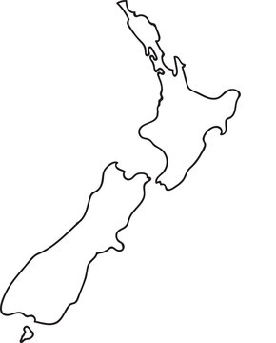
District structure
Create four new Districts – North Island
Upper NI (incl Samoa), Central NI,
Mid NI, Lower NI
Create four new Districts – South Island
Upper - West, Canterbury - Midland,
Otago, Southland
Notes:
Narrative
Proposing to consolidate Districts from a total of 15 to 8 – four in each Island
This is carefully considered and balances geography, concentration of numbers of Lodges and brethren, meets our current and future needs
There is some change, and there are some with distances to cover, which will be mitigated by using our rich team of Past GL Officers

Slide 30
District structure
Create four new Districts – North Island
Upper NI (incl Samoa), Central NI,
Mid NI, Lower NI
Create THREE new Districts – South Island
Upper - West, Canterbury - Midland,
Otago, Southland
Notes:
Narrative
Proposing to consolidate Districts from a total of 15 to 8 – four in each Island
This is carefully considered and balances geography, concentration of numbers of Lodges and brethren, meets our current and future needs
There is some change, and there are some with distances to cover, which will be mitigated by using our rich team of Past GL Officers

Slide 31
Grand Master
Deputy Grand Master
Grand Chaplain
Grand Superintendent of Ceremonies
Ceremonial Team
Grand Superintendent of Education
District Education Officers x 8
Grand Secretary
Grand Registrar
Grand Treasurer
Junior Grand Warden
District Grand Master UNI
District Team
District Team
District Grand Master CNI
District Team
District Grand Master LNI
District Team
Senior Grand Warden
District Grand Master U-W SI
District Team
District Grand Master C-M SI
District Team
District Grand Master Otago
District Team
District Grand Master Southland
District Team
Grand Superintendent of Works
District Grand Master Mid NI
Indicative Structure
Grand Almoner x 2
District Charity Officers x 8
Executive Director
National Office team
Grand Superintendent of Charity
Board of Directors
GL Trustees
Lodges and Brethren All
MW
RW
VW
No Grand Rank
W
Matrix reporting
No Grand rank- external
Notes:
Narrative
This is a summary view of the recommended structure – more detail will follow – showing that the Grand Master is connected to Lodges and brethren
The Grand Master leads the Craft with four reports; Dep GM, Grand Sec, SGW, JGW
Dist GMs report to the two Grand Wardens – one on each island, alternating Senior/Junior ranks
We have deliberately separated the Governance structure from the Operational structure – though these are linked in our day to day experience

Slide 32
Masonic Career Pathway ONE EXAMPLE
Worshipful Master x ~177
Deputy Grand Master x 1
Senior Grand Warden x 1
Junior Grand Warden x 1
Grand Steward (x 23)
Grand Master
District Grand Master x 8
G Supt Education x 1
Grand Almoner x 1
Dist Grand Director of Ceremonies x 8
Deputy Grand Almoner x 2
Grand Steward (x 23)
Dist Dev Officer x 8
Dist Admin Officer x 8
Dist Education Officer x 8
Dist Charity Officer x 8
Master Mason x ~4800
Notes:
Narrative
This is purely indicative of potential pathways, and is not a defined pathway to the next role
There are multiple options for Brethren wishing to make a contribution to Freemasonry
This does not replace the Constitutional rules or Collected Rulings relating to qualification for Office

Slide 33
Recommended District Changes
Recommending consolidation of geographically neighbouring Districts and retain significantly geographically diverse Districts, as below. The number of Lodges in amalgamated Districts will be mitigated by future Lodge closures and amalgamations. The smaller number of Lodges in retained Districts is due to their geographically dispersed location and challenges in travel time.
New District | Current Districts | Lodges | Members
Upper North Island | Amalgamate Districts; Northland, Auckland, Counties-Hauraki,, and include Lodge Calliope (Samoa) | 39 | 1191
Central North Island | Waikato, Bay of Plenty | 22 | 631
Mid North Island | Amalgamate Taranaki, Ruapehu, Eastland-Ruahine Districts | 30 | 638
Lower North Island | Amalgamate Districts; Hutt-Wairarapa, Kapiti-Wellington, re-aligning Ekatahuna Lodge to Mid NI District | 23 | 1166
Total | Four Districts | 114 | 3626
New District | Current Districts | Lodges | Members
Upper-West South Island | Nelson-Marlborough-West Coast District | 11 | 309
Canterbury- Midland District | Amalgamate Canterbury and Midland Districts | 25 | 762
Lower South Island | Otago District, Southland District | 27 | 760
Total | Three Districts | 63 | 1831
Notes:
Narrative
This is a summary of District change reocmmendations – showing current Lodge numbers and number of brethren

Slide 34
Next Steps

Slide 35
Next steps
Circulate a proposal for consultation – to every Brother
Receive your feedback
Check and Adjust the proposal
Develop Remits
Remits circulated for Annual Communication
Vote
Notes:
Narrative
This presentation is an overview, and more detail will follow
The next steps are;
A detailed proposal/recommendation document will be sent to every brother with a request for feedback
You will have two weeks to submit your feedback
The Working Group will collate and consolidate your feedback, consider the feedback and adjust if required
The WG will create Remits for the Annual Communication
The Remits will be circulated for your review
Lodges will vote on the Remits at the Annual Communication
Any changes will include a timeline, a transition plan and support for the changes

Slide 36
Questions

