Slide 1
TRUSTEE LIABILITY, PROPERTY & INSURANCE ISSUES
Report to divisional seminars
2024

Slide 2
TRUSTEE LIABILITY, PROPERTY & INSURANCE ISSUES
Starting principles:
All 3 issues are intrinsically linked together;
You can’t consider one issue without considering the effect of or on the other 2, but first;
You must understand how a trust works

Slide 3
How a trust works….
 | The Trust Document Often referred to as the Trust Deed
The Settlor(s) | The Trustee(s) | The Beneficiaries
…sets up the trust and settles property (assets) on the trust | …manage the assets of the trust for the beneficiaries | …members who the Settlor(s) choose to benefit from the assets

Slide 4
So, how does this apply to a lodge?
 | The Trust Document …in the case of a lodge, the By-Laws
The Settlor | The Trustee(s) | The Beneficiaries
…The Grand Lodge of Freemasons of New Zealand Trustee Act 1903 | …the Trustees of the lodge elected under the lodge By-Laws | …all the members of the lodge

Slide 5
What happens when a trust is wound up?
In the case of a family trust, normally the assets of the trust would be distributed to the beneficiaries.
In the case of a charitable trust, the trust deed normally provides for the assets to settled on another charitable trust with “similar aims and objectives”.

Slide 6
What happens when a Masonic trust (a Lodge) is wound up?
In a masonic context, the winding up of a trust is equivalent to a lodge either:
Electing to hand in its charter (rule 117 of the BoC), or;
Being dissolved as membership is less than 7 (rule 118 of the BoC).
When this happens, any “landed interests” (including any funds from the sale of any “landed interests”) held by the lodge, are transferred back to the Trustees of Grand Lodge for the benefit of the Building Fund.

Slide 7
So, for the avoidance of doubt…
Rule 2 (m) of the Book of Constitution (“BoC”) states:
Rule 120 of the BoC states:
So, please remember this as there will be frequent references to “Grand Lodge” throughout this presentation.

Slide 8
All trusts (including Lodge Trusts) are governed by the Trusts act 2019
…under which Trustees have 2 sets of duties:
Five (5) Mandatory Duties, and;
Ten (10) Default Duties

Slide 9
Now let's look at the mandatory duties and what they mean for lodge trustees
A duty to know the terms of the trust which, in a masonic context means…..
You must know your lodge By-Laws

Slide 10
Now let's look at the mandatory duties and what they mean for lodge trustees
A duty to act in accordance with the terms of the trust which, in a masonic context means…..
You must act according to your lodge By-Laws

Slide 11
Now let's look at the mandatory duties and what they mean for lodge trustees
A duty to act honestly and in good faith, which means…..
You must deal with people in an open manner and not mislead anyone

Slide 12
Now let's look at the mandatory duties and what they mean for lodge trustees
A duty to act for the benefit of the beneficiaries of the trust or to further the permitted purpose of the trust, which means…..
You must act for the benefit of all lodge brethren or for any purpose permitted by the By-Laws

Slide 13
Now let's look at the mandatory duties and what they mean for lodge trustees
A duty to exercise powers for the proper purpose, which means…..
You must not exercise any power for your own personal benefit or for any purpose not permitted by the lodge By-Laws

Slide 14
So, what are the default duties and what do they mean for lodge trustees
A general duty of care, which means…..
You must act in the best interest of all lodge brethren

Slide 15
So, what are the default duties and what do they mean for lodge trustees
A duty to invest prudently, which means…..
You must exercise the care and skill that any other person would exercise in a similar position, when making investment decisions

Slide 16
So, what are the default duties and what do they mean for lodge trustees
A duty to not to exercise power for your own benefit, which means…..
Exactly what it says!!!!

Slide 17
So, what are the default duties and what do they mean for lodge trustees
A duty to consider the exercise of power, which means…..
Be aware of your lodge By-Laws and only make decisions according to those By-Laws

Slide 18
So, what are the default duties and what do they mean for lodge trustees
A duty not to bind or commit trustees to future exercise or discretion, which means…..
Not to commit any future trustees of the lodge to any power that is not permitted by the By-Laws

Slide 19
So, what are the default duties and what do they mean for lodge trustees
A duty to avoid any conflict of interest, which means…..
Not to take part in any deliberations, or votes, where your personal interests or any duty you owe to another entity are likely to clash

Slide 20
So, what are the default duties and what do they mean for lodge trustees
Here are some examples of potential “conflict of interest”:
A lodge trustee is also a director of a company in which the lodge holds shares;
A lodge has a contract with an entity in which a trustee has an interest;
A lodge engages a family member of a trustee to undertake paid work for the lodge.

Slide 21
So, what are the default duties and what do they mean for lodge trustees
A duty of impartiality, which means…..
You must treat all brethren of your lodge equally

Slide 22
So, what are the default duties and what do they mean for lodge trustees
A duty not to profit, which means…..
You must avoid conflict between your interests as a trustee and the interests of the brethren of your lodge, act impartially in relation to the brethren and not make a profit from your trusteeship

Slide 23
So, what are the default duties and what do they mean for lodge trustees
A duty to act for no reward, which means…..
Exactly that!!!

Slide 24
So, what are the default duties and what do they mean for lodge trustees
A duty to act unanimously, which means…..
Exactly that!!!

Slide 25
What happens when a trustee retires, resigns or dies?
Liability for future events ceases, but;
Liability for historic events remains and may even be binding on the trustee’s estate;
Some liabilities may be limited by statute (law);
Some liabilities may be covered by insurance.

Slide 26
And one last very important point...
Section 45 of the Trusts Act 2019 requires each trustee to keep the following records:
The trust deed (the lodge By-Laws), including any changes;
Records that properly identify all the assets and liabilities, income and expenses of the trust;
Proper accounting records;
A record of all trustee decisions, including minutes of all meetings;
A copy of any written contracts that the trustees enter into.
In the case of a lodge, the trustees must instruct the secretary and treasurer to maintain these records on their behalf.

Slide 27
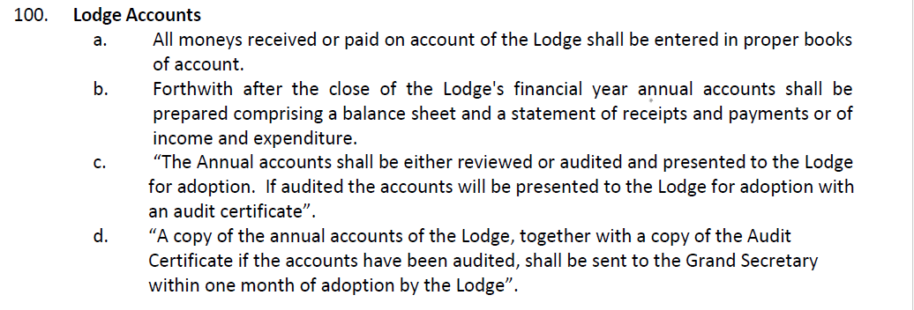
Now isn’t this a strange coincidence….
…so to does the Book of Constitution

Slide 28
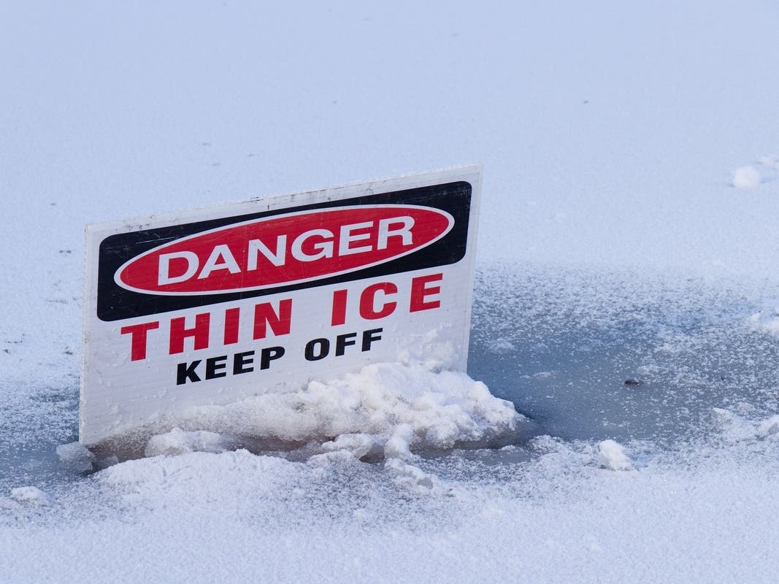
So…

Slide 29
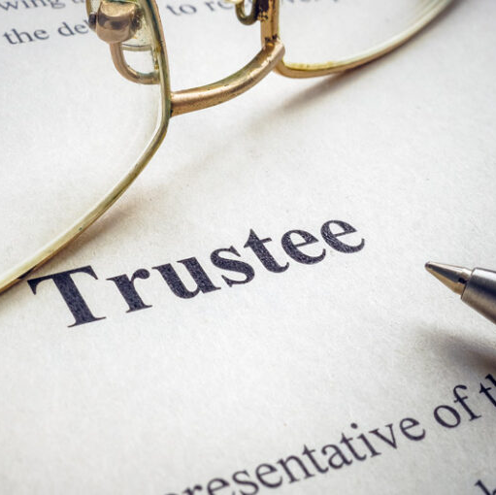
Questions on trustee duties

Slide 30
And a final comment about lodge by-laws…
RW Bro Noel King, Past Grand Registrar, prior to his untimely death, drafted a set of model by-laws that comply with the requirements of both the Trusts Act 2019 and the Book of Constitution.
These are available on the Freemasons NZ website under “2024 Seminars”.
Of most significance is the clause in many by-laws that limits the liability of trustees to the assets of the lodge (trust).
Under the Trusts Act 2019, many of these clauses are now invalid.

Slide 31
Why are some of these clauses now invalid?
Sections 40 and 41 of the Trusts Act 2019 state:

Slide 32
Why are some of these clauses now invalid?
Many lodge by-laws do not provide for “gross negligence”, which is a new concept in trust law introduced by the Trusts Act 2019.
“Gross negligence” is defined as:
“The conduct of a trustee was so unreasonable that no reasonable trustee in that trustee’s position and in the same circumstances would have considered the conduct to be in accordance with the role and duties of a trustee”

Slide 33
Now let’s talk about property & insurance issues
In late 2023, the Board expanded the remit of the Insurance Committee to include property issues, in particular:
To assess the risks associated with all masonic property;
Make recommendations to eliminate or minimise those risks, and;
Develop a long-term strategy for masonic property that recognises the needs of the membership and the limitations of the Grand Lodge balance sheet.

Slide 34
property & insurance committee
W Bro Cameron Smith, Chairman
RW Bro Paul Chappel, Deputy Grand Master
RW Bro Neville Patrick, Past Deputy Grand Master & Chairman of the Grand Lodge Trustees
To make it very clear, the committee can only recommend a course of action to the Board, it cannot approve that course of action
And contrary to popular myth, “we are here to help”

Slide 35
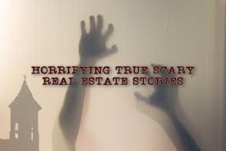
Let’s begin with a few horror stories

Slide 36
Let’s begin with a few horror stories
A combination of bad decisions and unforeseen circumstances resulting in a loss of value (to the brethren of certain lodges) in excess of 8 million dollars ($8,000,000);
A number of masonic properties that are in breach of the Health & Safety at Work Act 2015 and/or do not have a Building Warrant of Fitness, despite being required to do so;
Loans from the Building Fund to masonic entities that have significant repayment arrears;
Outstanding maintenance on a building causing a commercial tenant to threaten legal action against the masonic owner;
Masonic property-owning entities established as charitable trusts operating (probably) in breach of both the Charities and Income Tax Acts.

Slide 37
Now, this is important…
A loss of value or the failure to pay interest on a loan impacts on all members of Grand Lodge, not just the members of the lodge(s) or masonic entities involved, and;
A failure to comply with statutory compliance obligations affects the reputation of all of us, not just a lodge or masonic entity that breaches those compliance obligations, so…

Slide 38
…Let’s not adopt the insular attitude of…

Slide 39
What are the problems?
An aging property portfolio with ever increasing maintenance and insurance costs;
Declining revenue from declining membership and “peppercorn” rents paid by masonic tenants in both masonic and mixed use (commercial/masonic) properties;
In mixed use properties, the surplus generated from commercial tenants is reducing to the extent that it will no longer “offset” the loss from masonic tenants;
Commercial tenant risk in mixed use properties;
In mixed use properties, no provision for long-term maintenance, and;
“Enthusiastic amateurs” with an “emotional”, rather than an “objective” attachment to masonic property.

Slide 40
Can someone tell me what the difference between this…

Slide 41
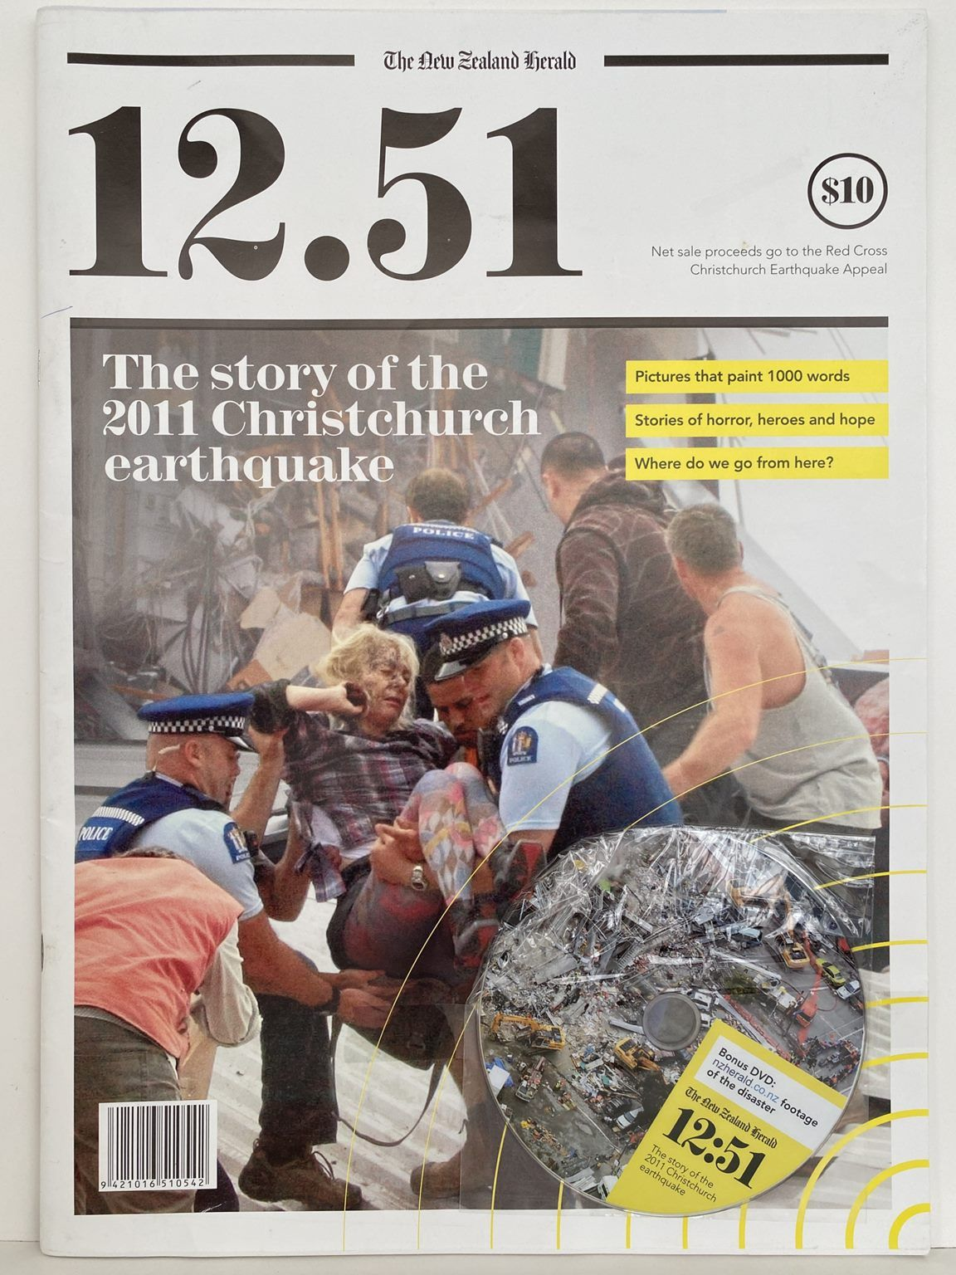
And this is?

Slide 42
The answer?

Slide 43
So, why is this important?
Since the introduction of the Act in 2015, Worksafe now has legislation that gives it “teeth” in prosecuting breaches of the Act;
The Whakaari White Island prosecutions are a good example of this where Worksafe brought charges against 13 defendants including tour operators and the operator and owners of the island;
6 charges were dismissed, 6 defendants pleaded guilty, and the owner of the island pleaded not guilty to one charge but was convicted after trial;
More than $10.2 million was awarded in reparations and more than $2.0 million in fines.
Reparations can be insured; fines must be paid by the defendants and are not insurable.

Slide 44
So, why is this important?
Firstly, volunteer organisations do not have health & safety obligations under the Act unless:
The organisation has paid employees, eg, Freemasons NZ, or;
The organisation is a profit-making entity, eg masonic properties that are leased/rented for “gain”.
There is section in the Act that refers to “take all reasonably practicable steps to ensure the safety of workers and others who may be affected by the PCBU” (person conducting a business or undertaking).
In the Whakaari White Island prosecutions the Court, among other issues, determined that the defendants could have taken additional steps to prevent harm, even though they had put safety measures in place.

Slide 45
So, why is this important?
There are a number of factors that affect what is “reasonably practicable”, but foremost among these is an obligation on a masonic PCBU to undertake a comprehensive and thorough risk assessment.
Freemasons NZ maintain (at their cost) an insurance policy that covers most masonic entities (lodges, companies, trusts etc) for:
Officer’s liability;
Statutory liability, and;
Public liability.
Officers and statutory liability insurance covers the cost of any reparations (damages) awarded against the insured party PLUS the defence (legal) costs of defending a claim, but not any fines.

Slide 46
So, why is this important?
Question: Can an insurer decline a claim if the insured party has not taken all “reasonably practicable steps” to ensure the safety of workers and others?
Answer: Yes, it will not be sufficient to merely have safety measures in place, a masonic PCBU must undertake a comprehensive and thorough risk assessment.
This means that all masonic PCBU’s must:
Implement proper safety measures, and;
Undertake a comprehensive and thorough risk assessment in order to:
Comply with their obligations under the Act, and;
Comply with their obligations under the liability insurance policies.

Slide 47
So, once again…

Slide 48
Questions on property issues

Slide 49
…and what about insurance issues?
To recap from the 2023 renewal:
All entities covered under the Grand Lodge Group Insurance Scheme (“GLGIS”) obtained cover on acceptable terms
We used 2 brokers to facilitate cover:
Gallagher's obtained cover for the “good risks”, and;
Neville Newcombe obtained cover for the “not so good risks”;
Each entity was individually rated according to their risk profile, and;
There were some “winners and losers”.

Slide 50
…so, what can we expect for the 2024 renewal (due on 31st August?
Material damage premium rates for buildings are expected to increase between 7% and 10%, according to industry sources;
Insurers are becoming increasingly nervous about insuring building risks that are pre-1935 or where the NBS rating (the earthquake rating) is less than 33%;
Insurers are paying much closer attention to building risks where the risk of a claim is exasperated by outstanding long-term maintenance issues;
An RFP document will soon be distributed to 3 reputable insurance brokers with details of all the risks to be covered under the GLGIS.

Slide 51
What does this mean for masonic properties?
There will be premium rate increases but for “good risks”, these are expected to be minimal;
Buildings that are less than 33% of the NBS standard, are pre-1935 or have outstanding long-term maintenance issues can expect;
Premium rate increases in excess of 7%, and/or;
Specific policy exclusions and/or;
Claims being declined or limited even if outstanding long-term maintenance issues are disclosed to the insurer.

Slide 52
What does this mean for masonic property-owning entities?
If the property-owning entity has a healthy income and balance sheet, the impact will be easily managed;
If the property-owning entity is loss-making, has limited income or cash reserves, the trustees/directors may have to consider:
Insuring for indemnity cover only, or;
Insuring for demolition cover if the property is deemed “non-strategic, or;
Not insuring at all, or in a “worst case”;
Selling the property.

Slide 53
What happens when you insure for less than replacement value?
Let’s assume that a property has a replacement value of $1,000,000, and;
You insure the property for, say $500,000;
How much will you receive in the event of claim for “total loss”?
Answer, $250,000, because;
An insurance term known as “subject to average”;
$500,000 / $1,000,000 = 50%
50% of $500,000 = $250,000

Slide 54
Why might an insurer decline or limit a claim if there are outstanding long-term maintenance issues?
Reduction for unrepaired items – This clause allows an insurer to reduce any claim for loss that occurred for maintenance that has not been repaired, replaced or reinstated;
Gradual damage – Gradual damage is usually subject to a maximum limit of $10,000;
Building defects – A policy does not cover exposure to weather unless reasonable precautions have been taken to protect the property from weather conditions;

Slide 55
Why might an insurer decline or limit a claim if there are outstanding long-term maintenance issues?
Loss or damage not covered - A policy does not cover slowly developing deformation or distortion, gradual deterioration or rot;
Normal working, wear, tear and corrosion – An exclusion applies to the part (or parts) of the property where the loss was caused by normal working, wear and tear, corrosion or maintenance.
If a claim is either declined or limited (by amount), there are significant implications, in particular, for trustees/directors of “mixed use” properties.

Slide 56
What should trustees/directors do if insurance premiums are unaffordable of it is uneconomic to replace the building?
If the property-owning entity is loss-making, has limited income or cash reserves, the trustees/directors may have to consider:
Insuring for indemnity cover only, or;
Insuring for demolition cover if the property is deemed “non-strategic, or;
Not insuring at all, or in a “worst case”;
Selling the property.

Slide 57
What should trustees/directors do if insurance premiums are unaffordable of it is uneconomic to replace the building?
If the trustees/directors elect to insure the building for less than replacement value, then:
The lodge members (or the shareholders in the case of a company) must pass a resolution that details the reasons for doing so, and authorise the trustees/directors to insure for less than replacement value, and;
The trustees (or the directors in the case of a company) must also pass a resolution that details the reasons for doing so and acknowledge that they have been authorised to do so by the lodge members/shareholders.

Slide 58
What should trustees/directors do if insurance premiums are unaffordable of it is uneconomic to replace the building?
If you go to…
https://freemasonsnz.org/2024-seminars
…you will find draft lodge and trustee resolutions that can be used for this purpose. These resolutions can be easily modified for use by a company.
For lodges and lodge trustees, the it is important to note the following clauses in both the resolutions of the lodge (members) and the trustees:

Slide 59
What should trustees/directors do if insurance premiums are unaffordable of it is uneconomic to replace the building?
Lodge members resolution:
“Moved by <name (not a Trustee)>, seconded by <name (not a Trustee)>, that the Secretary of the Lodge be directed to send a copy of this resolution to the Executive Director of Freemasons NZ for the attention of the Trustees of the Grand Lodge of New Zealand.”
Lodge trustee’s resolution:
“Moved by <name of trustee>, seconded by <name of trustee>, that the Secretary of the Lodge be directed to send a copy of this resolution (including a copy of the Lodge resolution) to the Executive Director of Freemasons NZ for the attention of the Trustees of the Grand Lodge of New Zealand.”

Slide 60
Why do the trustees of grand lodge need to be advised?
Both the lodge trustees and Grand Lodge trustees are governed by the Grand Lodge of Freemasons of NZ Trustee Act 1903;
If a property is insured for less than replacement value (or not insured at all), the Grand Lodge Trustees may be liable in the event of a loss;
To mitigate their liability, the Grand Lodge trustees have the same options available to them as lodge trustees, namely:
To pass a resolution that details the reasons for doing so, or;
Sell the property.

Slide 61
So, at the risk of sounding like a broken record…

Slide 62
Questions on insurance issues

Slide 63
Questions for the future?
Given the significant liability issues associated with, in particular, mixed-use (masonic/commercial) property should we:
“Stick to our knitting” and only own/build dedicated masonic property?
Do we need more than 100 properties with a combined value in excess of $150 to $200 million for a membership of about 5,000?
If you were asked “what are the strategic masonic locations in your district or division”, what would your answer be?

Slide 64
answers for the future?
Let us know what you think and email any “answers for the future” or any suggestions/ideas to:
secretary@freemasonsnz.org

